Slide 1
Perception, Cognition and
For Graph Design
By
Daniel B. Carr
George Mason University

Slide 2
Overview
The Big picture
Expertise
Guidelines and more examples
Audiences and media
References

Slide 3
Design for the Task
Communication, teaching, learning
Summaries
Visual stories and explanations
Problems: Establish, elaborate and resolve
Discovery and hypothesis generation
Comparative views to let the data speak
Changes of context and visual perspective
Searching tools
Analysis
Visual analytics
Models and model criticism
Decision Making
Actionable graphics

Slide 4
Design for the Audience
We are often the audience
General audience considerations
Language, knowledge, skills, expectations
Broad cultural representation conventions
Discipline based conventions and preferences
Geography: colors scales for elevation
Individual specific limitations and abilities
Visual acuity, color blindness, etc.
Regulation 508b
Sensory encodings are universal
Low level processing in V1, V2 parts of the brain

Slide 5
Human Perception is an Active Process
We continuously structure our sensory input
The structuring works simultaneously on different scales - Marr
We are unaware of many facets of this structuring
The two eyes each have a blind spot.
We do not "see" the blind spots
Blood vessel are in front to the cones
We do not normally see the blood vessels
"The mind is not a camera." - Kosslyn

Slide 6
Simultaneous Perceptual Grouping at Different Scales
Adapted from
Jose Marroquin 1976

Slide 7
Perception and Cognition
Depends on
What is out there
Human hardware (the senses + carbon-based chip)
Our senses are limited
See a tiny part of the electromagnetic radiation spectrum
Wavelengths 400 to 700 nanometers
Our carbon-based chip heavily processes the sensory input
Optical illusions, negative and positive "hallucinations“
Respond to change and adaptation
Our visual, auditory, and kinesthetic memories are tiny, require huge resources
Hold three simple chunks of information
Auditory: 2 second sound loop, internal dialogue
Our consciousness awareness is limit and delayed
Visual input 10⁷ bps, Auditory input 10⁶ bps, Motor Output 10⁷ bps
Consciousness 16 bps

Slide 9
Human Processing Rates: Adapted from Norretranders
Stimuli | Bits/sec
Optical | 1 * 10⁷
Acoustic | 1 * 10⁶
Tactile | 4 * 10⁵
Thermal | 5 * 10³
Proprioceptive | 1 * 10³
Olfactory | 2 * 10
Gustatory | 1 * 10
Action | 10⁷ Bits/sec
Skeletal | 32%
Hand | 26%
Language | 23%
Facial | 19%
Consciousness | Bits/sec
Eyes | 40
Ears | 30
Skin | 5
Taste | 1
Smell | 1

Slide 10
Perception and Cognition
Depends on
Attention
Top down. Constant linking and re-linking of different visual
information with different kinds of nonvisual information
Our world view
We try to make sense of things based on our learned world view
We emphasize compatible information
We discount incompatible information and may not even see it
About 95% of what we “see” is really from long term memory
Gist
We get the gist of a scene in 1/10 of a second
This speed is not understood
Priming
Processing images facilitates processing of similar (or same) images
An implicit processing decision pathway or readiness memory

Slide 11
Attention
Our ability to shift attention is amazing
What is little toe on your left foot feeling?
Are you hungry?
Are you eyes tired?
Why didn’t you hear what I said?
I was focused on my little toe
Features the pop out are those for which we can tune our vision
We can scan the room for red objects
Pop out features are important in visual communication
Attention narrows in a crisis
Blinking light at the sides of screen go unseen.
Sirens go unheard
A physical prods go unfelt
But a voice by an ear can whisper “Daddy” and be heard

Slide 12
Representation Systems
Sensory Abstract
Visual Auditory Verbal, Geometric, Algebraic
Kinesthetic Olfactory
Representations can be external or internal
Much of our brain is devoted to visual processing
External representations extend our thinking abilities
Our short term memories are quite limited
Computer-assisted transformations enable deeper thought
Learning: non-reflexive transformation between representations
A => B B => A*
2D plot => 3D plot with emergent pattern => 2D plot seems deficient
Thought can involve several representation systems
Geometric representations can serve as a bridge

Slide 13
Graphs and Words
Scientific communication almost always involves words
The ability to describe a plot in words is important
Many things compete for the reader’s attention
Word can guide attention and cause things to pop out.
Transforming what we see helps us remember
Describing a graph in words helps us remember
Combining diagrams and spoken words is powerful
We have separate visual and auditory memory
Written words compete visually with the diagrams
(Hearing new words spoken is helpful)

Slide 14
Animation
Our retinal memory fades fast
We can only name a few things in a flashed image
When our eyes jump we are mostly blind
Animation wipes out the previous image, we note change
Conversion to words and word memory is problematic
Music can link emotion to the animation
The flyover with exciting music
Mountains, valleys, green trees, blue bay
No time to think, few words to say
Verbal priming and anchoring can help with
noticing and retention
Rocking or slow rotation
Provides 3-D appearance, gives time for words

Slide 15
Learning
Performance on a new task often has a heavy cognitive component and is slow
Practice increases performance accuracy and speed, and the cognitive component can drop out
Key punch operators could chat while entering numbers
Practices yield continuing but diminishing returns

Slide 16
Observations on Communications
Many devoted to updating slots in our world models
The current price of gasoline
The results of the football playoff games
Many devoted to manipulation, obfuscation and deception
Commercials
The manufacturer’s suggested retail price
Political estimates of costs and future tax revenues
Hiding the flow of money
Many graphics based on convenience and ritual
Good or bad, spreadsheet graphics are convenient
Why improve if it doesn’t increase sales?
Other people use them so they are readily accepted
Form can be more important than content and understanding
Entertainment is important
How many top notch scientists, data analysts, and intelligence analysts
can be hired for the salary of star baseball player?

Slide 17
Sources of Common Practice
Historical designs
Old innovations
Institutional practice, following what has been done
Software
Programming for old designs
Implementing what was easy
1970’s business graphics have had a strong influence
Human perception and cognition
Old knowledge
Conventions
Cultural
Individual disciplines
Software: designs and defaults
Previous technology limitations

Slide 18
Sources of Evolution
Technology advances
Data availability
Modeling and analytic capabilities
Rendering capabilities: monitors, projectors, printers
Software development sophistication
Marketing forces and societal needs and market
Cultural sharing and competition
International exchange
Cross disciplinary exchange
Expert opinion
Research
Human perception and cognition
Usability assessment

Slide 19
Domains of Expertise
Graphics designers
Quantitative, Artistic, commercial
Publishers and web designers
Newspapers, Journals, Books, Federal agencies
Software developers
Adobe, Macromedia, Excel, SAS, ESRI, SPSS, …
Research communities – all are important
Human perception and cognition
Statistical graphics - class biased in this direction
Geography, cartography
Scientific visualization
Medical, satellite imagery, computational fluid dynamics
Information visualization
Usability and human computer interface
Computer vision
Computer graphics and games

Slide 20
Experts With Broad Perspective
Statistics
W. S. (Bill) Cleveland
Leland Wilkinson
General Design
Edward Tufte
Cognitive Science
Colin Ware
Steven Kosslyn
Steven Palmer

Slide 21
Three Psychophysics Laws
1. Steven’s Power Law: p(x) = ax^{b}
p is the perceived scale, x is the magnitude of the attribute
a is the multiplicative constant, b is the power
Experimental results for b
b Heuristic
Length .9 to 1.1 1 ^{-.5}
Area: .6 to .9 2 ^{.-5}
Volume .5 to .8, 3 ^{.-5}
Elec. Shock >
Area example: x₁ = 4, x₂ = 1, assume b = 2 ^{-.5} = .71
p(x₁) / p(x₂) = (4/1)^{.71} = 2.7
The larger area appears 2.7 times, not 4 times larger.
We under judge the larger areas.

Slide 22
Three Psychophysics Laws
2. Weber’s Law
Let x be the magnitude of a physical attribute of an object.
Let x + w_{p}(x) be the magnitude of a second object.
The subscript p the probability that a person perceives the
second object to have the larger magnitude.
Weber's Law is w_{p} (x) = k_{p} x
Fixing k, the fractional stimulus increment, fixes p
while x can change over a wide range of stimulus magnitudes
p is constant when comparing 1 to 1.01 or 100 to 101 centimeters
The later difference is 100 times larger.
Tick marks on a ruler help use measure more accurately
Grid lines help assess values, positions of minima etc.
Fixed length framing of bars helps us compare lengths

Slide 23
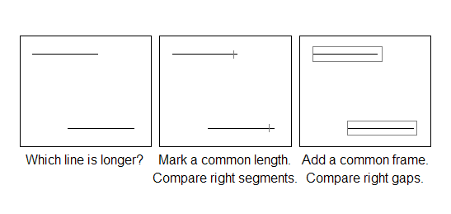
Weber's Law
Just noticeable differences and probability of detection
Are related to the ratios of stimuli magnitudes
Difference detection is more likely when ratios are further from 1
The line lengths on the left have ratio of 1.02
Magnifying the panel won’t help in detecting the difference

Slide 24
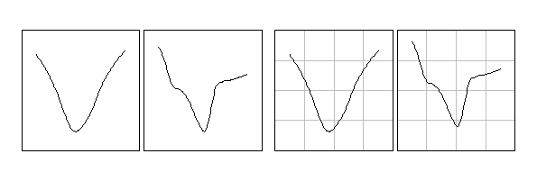
Weber's Law and
Pattern Perception
Grid lines helps us compare and assess patterns
Consider comparing the x and y location of x and y minima without and with background grid lines

Slide 25
Three Psychophysics Laws
3. Adaptation and response to change
Eye-locked images
The eyes tremor with a movement of about 1 cone. The response to an eye-tremor locked image rapidly diminishes. The whole image goes gray.
Afterimages
The cone response diminishes to any continuously present color. After adapting to red saturated image, a white image will briefly appear to have the complementary color.
Temperature
When one gets in a shower it may seem hot, but after a while people often turn the temperature up. Humans have pain threshold. I have heard that one can boil a frog alive by gradually increasing the temperature.

Slide 26
The Eye
The retinae
Cone rich central area containing the fovea
1 degree of arc, 6 million cones, high acuity color vision
Non-central area
120 million rods, Low intensity light, achromatic vision
Blind spot
Lens-cornea power: 59 diopters
cornea = 49 diopters + ciliary muscle controlled thickness = 15 diopters
simple lens power = 1/object_distant + 1/focal_distance.
Diopters units = 1/meter
Movement:
Tremor, saccades, pursuit, convergence, accommodation

Slide 27
Terminology and Guidelines
Terminology and construction
Data versus scale line rectangles
Superposed, juxtaposed panels, differences
Nice scales for ticks and grid lines
Four general principles related cognitive considerations
Enable accurate comparisons
Simplify appearance
Provide context for interpretation
Engage the read/analyst

Slide 28
Cleveland’sTerminology

Slide 29
Cleveland’s Guidance
The scale rectangle should be larger than the data rectangle
Do not plot data points or lines on the scale rectangle outline
Reference lines may extend to scale rectangle outline
Should the scale line have ticks at the ends?
Grid lines improve perceptual accuracy of extraction
Weber’s law
Use visually prominent graphical elements to show the data
Grid lines should appear in the background
The tick marks should point outward
This keeps tick marks from obscuring data points
Grid lines don’t need tick mark. (Carr)
Cleveland uses a vertical label for the y-axis
Some packages use horizontal labels near the top left of the scale rectangle
What is better? (Carr)

Slide 30
Superimposed Time Series

Slide 31
Juxtaposed Series

Slide 32
Change Blindness and Juxtaposition
When our eyes jump (saccades) there is no input
The old image fades in 1/5 second
The small part under scrutiny is retained longer
We are blind to changes in other parts of the image
Careful comparison of juxtaposed images involves scrutiny
Rapid alternation of almost identical images
Used by astronomers to find change between almost identical photos
Changes appear as blinking
Inserting a blank image between images emulates change blindness
Small panels with modest content are easier to compare than large plots

Slide 33
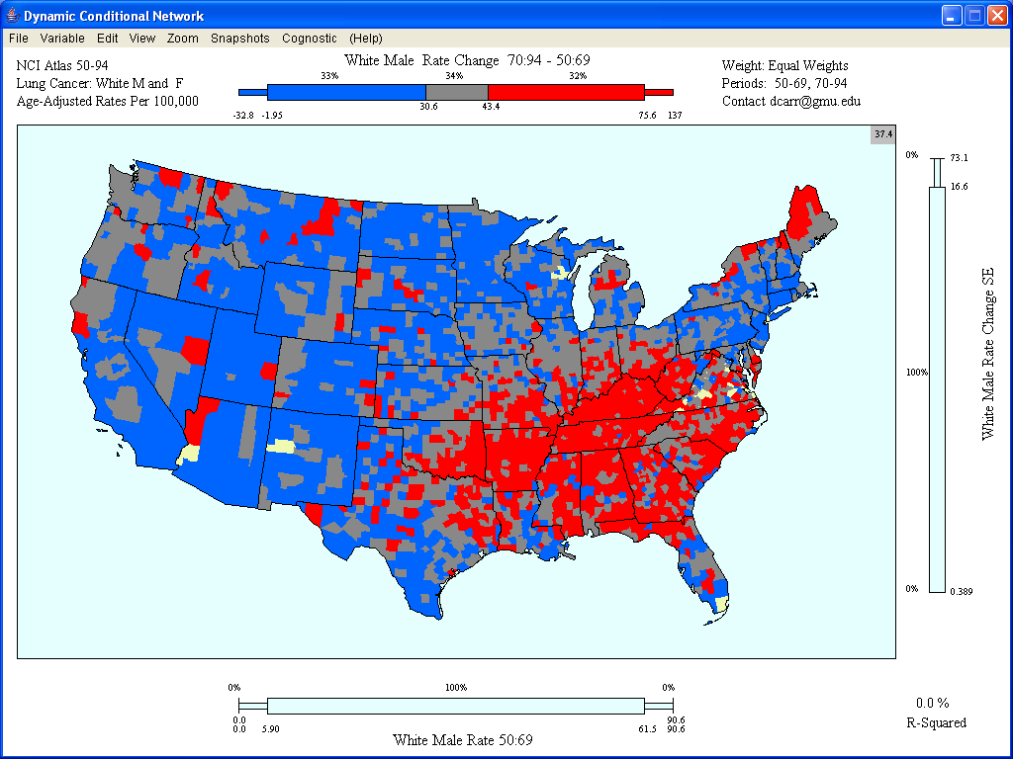

Slide 35


Slide 37
We don’t compare curves very accurately

Slide 38
Even for binary maps, it helps to show explicit differences

Slide 39
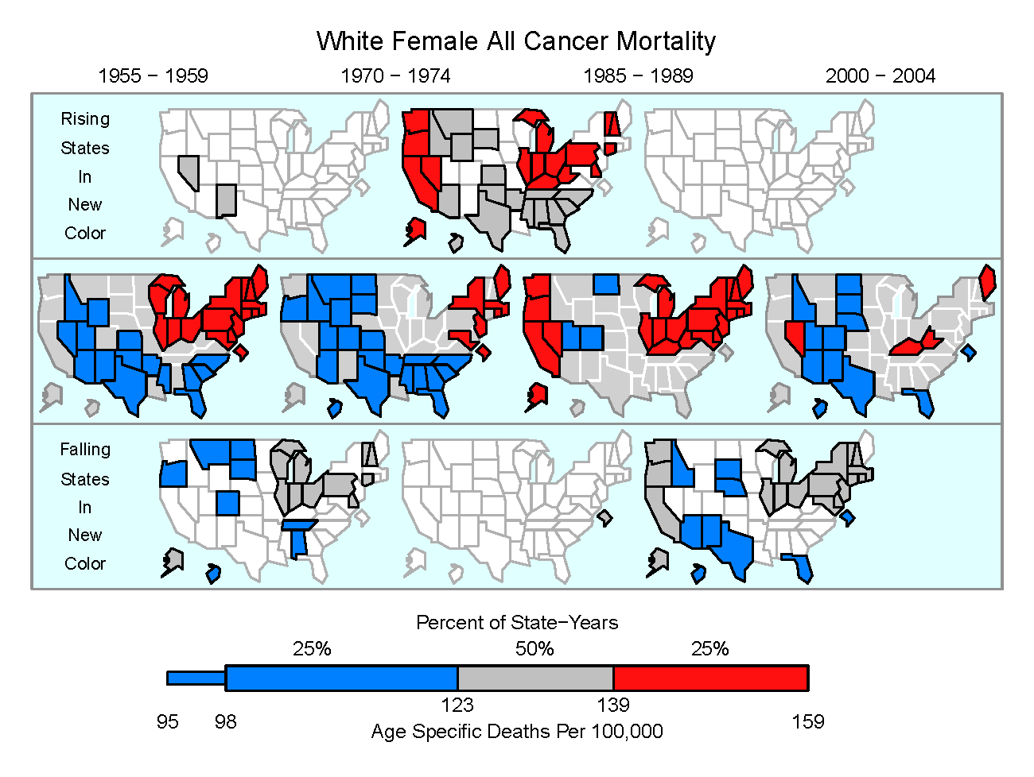

Slide 40
Nice Scales
Nice numbers are those we preferred as children
Wilkinson: ”A nice scale is an interval scale marked with an ordered
sequence of numbers whose first differences are nice numbers.”
… 1, 2, 3, 4, 5, … Difference 1
… 2, 4, 6, 8, 10, … Difference 2
…0, 50, 100, 150, 200, … Difference 50
Really nice scales include zero.
Algorithms producing nice scales (tick mark locations) are complex
Select a set of nice numbers, say (1, 5, 2, 25, 3) in preference order
Search through candidate scales
Evaluate each based on weighted average of criteria:
Simplicity, granularity, coverage

Slide 41
The Heart of Quantitative Graphics
Comparison, Comparison, Comparison
Four general goals under tension
Enable accurate comparisons
Simply appearance
Provide context for interpretation
Engage the reader/analyst

Slide 42
1 - Encourage Accurate Comparisons
Use visual encodings with high perceptual accuracy of extraction
Best encodings: Position along a scale or along identical scales
Grid lines increase decoding and shape comparison accuracy
Good examples: Dot plots, bar charts, scatter plots, time series plots
Comparison layouts
Superimpose
Juxtapose with comparable scales
Show differences explicitly
Comparison accuracy decreases with distance
Organize to make key items for comparison close together
Context is important in comparisons
Provide reference lines
Control extraneous sources of variation

Slide 43
Rankings for Perceptual Accuracy of Extraction
Best
Position along a scale
Position along identical non aligned scales
Good
Length
Angle
Direction
Poor
Area, volume,
Density, curvature,
Gray level, color saturation, hue
Adapted From Cleveland

Slide 45
Designs Using Position Along A Scale
Labeled 1-D plots
Bar plots: scale starts at zero
stacking degrades bars to a length encoding
Dots, confidence intervals, arrows, and box plots
scale focuses on the data range
Scatterplots: scale focuses on the data range
Enhancements
Functional relationship: add a model line or non-parametric smooth
Density patterns: avoid overplotting, can compute and show density Matrices linked brushing and conditioned views
Time series plots: scale focuses on the data range
Stacking: degrades encoding to length and emphasizes area
Focus: logical/perceptual grouping, pan and zoom, fisheye lens
Labels: proximity or right label (last value most relevant)

Slide 46
Comparable Scales

Slide 47
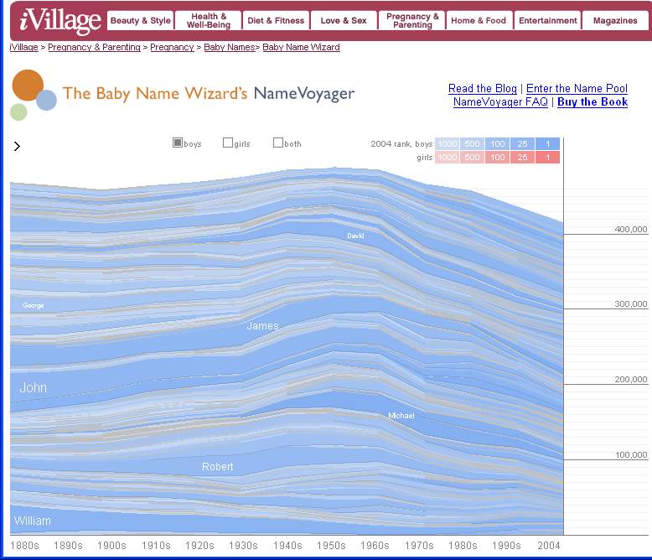
http://babynamewizard.com/namevoyager/lnv0105.html

Slide 48
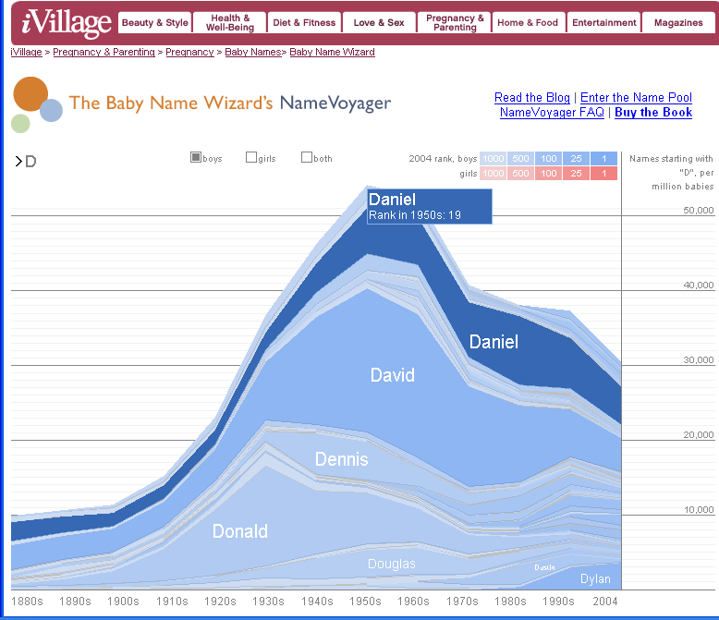
http://babynamewizard.com/namevoyager/lnv0105.html

Slide 49
NameVoyager
Drew many people into analysis and web conversation!
An important first step
Designer: Martin Wattenberger
A person to watch for his graphics designs
Layered time series
Avoids overplotting
Less space than stacking individual plots
Visual assessment involves difference of two curves
Kosslyn: for accurate reading avoid layer graphs
For comparison of two curves show differences explicitly

Slide 50
2 - Simplify Appearance
Provide intermediate levels of organization
Create small perceptual groups
Layer information with the most important appearing the closest
Use caricatures and hide details
Exploit the ease and speed of preattentive vision - minimize the need for scrutiny
Use easily discriminated symbols and colors
Promote readability and visibility
Horizontal text, sufficient size, limit use of capital letters
Address overplotting
Limit memory and calculation burdens
Close proximity labeling are better than linked labels
Links when necessary should be easily remembered (hues)
Guide the eyes
Sort cases to shorten visual traversal paths, limit visual barriers
Avoid
Redundant information, optical vibration, brightness noise, multiple scales on the same axis

Slide 51
Big Picture Expertise Guidelines/Examples Media/Audiences References
Perceptual Grouping Methods

Slide 52
Perceptual Grouping Uses
Proximity based pattern perception in scatterplots
Proximity based labeling in time series
Avoids color and texture linking methods that requires memory
Promotes comparisons between groups
Panels (enclosure) provide an intermediate layer of organization
Simplifies appearance and reduces visual intimidation
Can create visual entry points in long lists
Promotes focused internal comparisons
Performance declines for groups larger than 4
Allows fast linking across attributes of the same cases

Slide 53
Two panels with three lines
look simple
A panel with six lines
looks complex
Adapted from Steven Kosslyn, 1994

Slide 55
Row-labeled Plots
Assigns a separate row to represent each case
The row-label is the case name or id
Horizontal text is good for reading
Represents values of a variable in a column
Estimates, percent change, etc. : dots or bars
Change: arrows
Distributional summaries: box plots
Features
Perceptual grouping of rows
Sorting of rows and sometime columns
Scaling for comparability
Extensions based on within panel links such as color
Time series plots
Scatter plots
Link micromaps

Slide 58
Time Series: Sorting and Scaling
Time series can be sorted by a variable and grouped into panels
Computed variable to use in sorting the series
Median (Cleveland)
Average
Maximum
Minimal spanning tree traversal-each series a point in p dimensions
First principal component, etc.
Grouping per panel: 4 or less preferable
Panels scaling issue/tension
Global scale hides patterns in small range time series
Interactive/dynamic scaling and regroup choices are desirable

Slide 60
Color
Many issues and details
Color surround influences color perception
Color blindness
Different media are not equally adept at producing colors
Most color pallets don’t have equal perceptual steps
We often want easy discrimination
There are many ways to specify color
An excellent resource: www.colorbrewer.org
Three basic colors schemes:
Sequential: Good for ordered data and gray level reproduction
Divergent: Good for ordered categories with a central category
(model residuals can have zero as central category)
Qualitative: Good for a few unordered categories

Slide 61
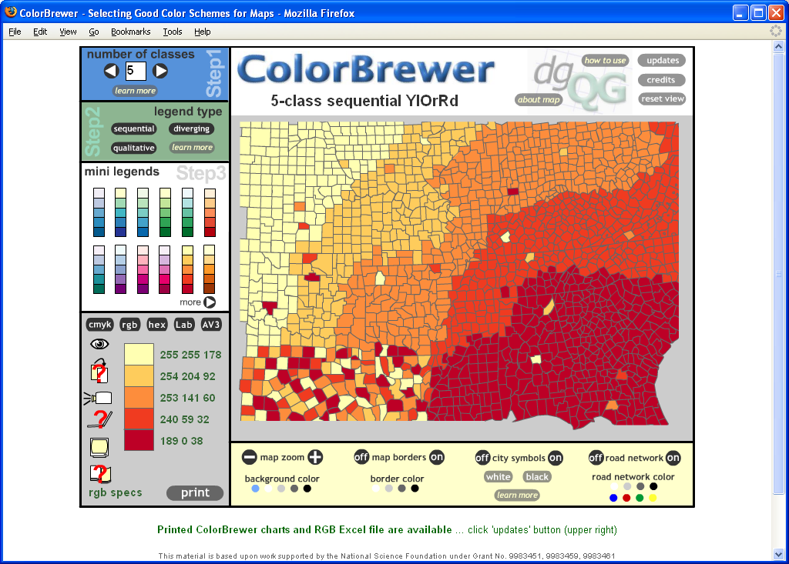

Slide 62
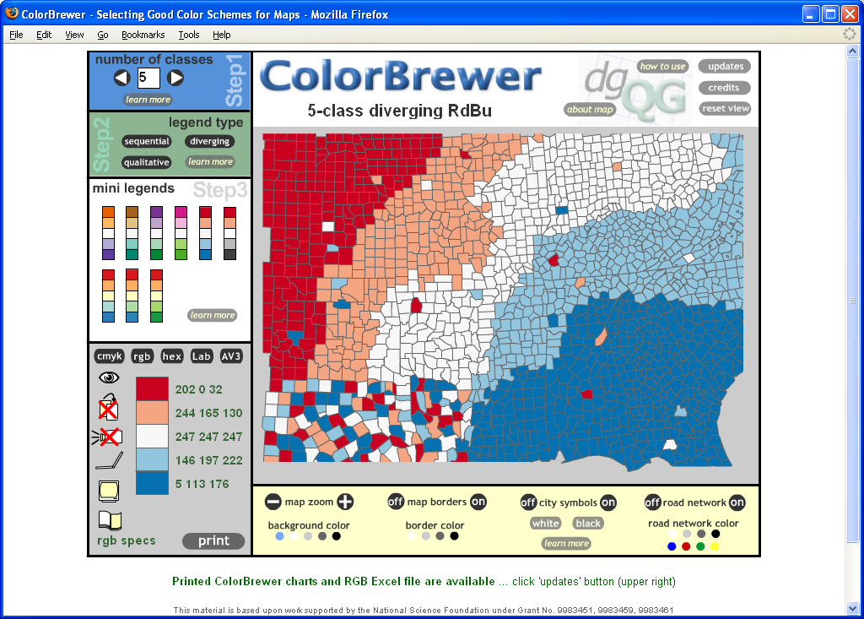

Slide 63
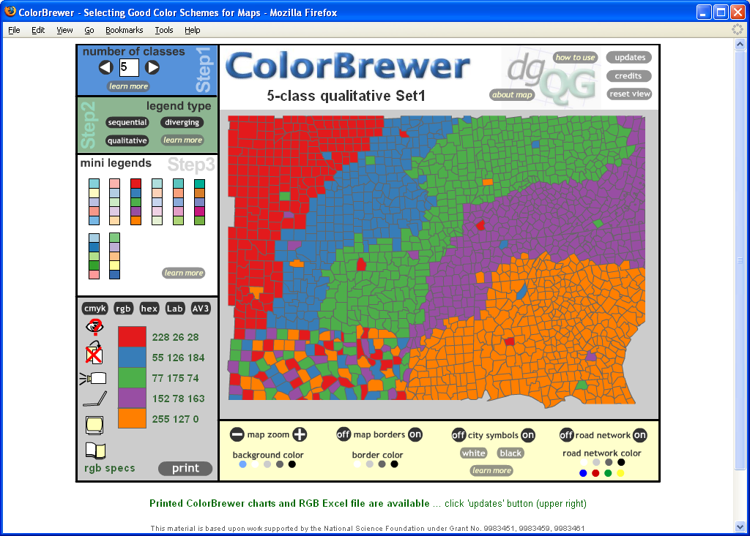

Slide 64
Attentive and Preattentive Vision
Attentive vision
Scrutiny – Slow serial search by a small aperture of focal attention
Preattentive Vision
Fast parallel processing
Controls foveal attention that then determines what is present
Features Pre-attentively processed
Form: Line orientation Curvature Size
Line length Spatial grouping Orientation
Line width Added marks Crossing
Line colinearity Numerosity Enclosure
Shape
Color: Hue, intensity
Motion: Flicker rate, direction of motion
Spatial: 2D position, stereoscopic depth, convex/concave
Position: shape from shading
Usage: Highlighting, rapid discrimination, guidance of the eyes
Give a dot on a line twice the diameter as the line width
From Ware, Julesz, Kosslyn

Slide 65
Preattentive Discrimination:
Are you sure there are just two different items in the top left panel?

Slide 66
Integral versus Separable Encodings
We respond to some visual encodings wholistically
These are called integral encodings
Integral encodings should show just one variable
Rectangles:
We respond directly to area
They have length and width
Fix the width so length and area are equivalent
Color:
Has 3 dimensions: hue, lightness and saturation
Encode just one variable using color
Separable encodings that work with two variables
Symbol color and shape

Slide 67
3 - Provide Context for Appropriate Interpretation
Cover W⁵H²
Who, what, where, when, why, how and how well
Overview first and then detail on demand – HCI mantra
Use multivariate displays and alternative views
Multiple panel graphics
Linked information
Maps
Competes with showing data and simple appearance
Tufte says: “Above all else show the data”
Long or legalistic footnotes are a problem
Metadata can grow exponentially
Recommendations: Simplify appearance, link to extensive detail

Slide 68
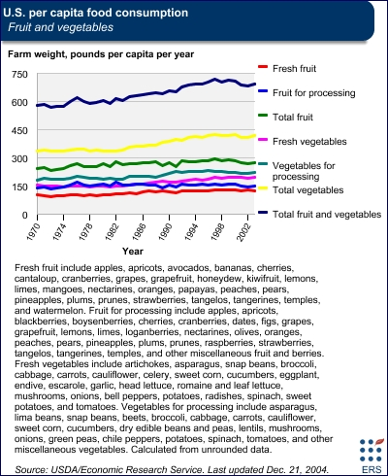

Slide 71
4 - Engage the Reader or the Analyst
Provide content and appearance options
Variable selection, filtering and sorting, linking, conditioning
Rankings and egocentric views (relative to my state, county, etc.)
Panning, zooming, progressive disclosure, mouseovers
Provide appearance of value added (personal opinion)
Embellish but maintain good accuracy and comparability
Depth via lighting models and shadows – important things go in front
Color coordination – light green background in the green section
Add visual analytics (statistical feedback and view selection guidance)
Provide output and data analysis management options
Print friendly output, import results into other software
Set personal preferences, save comments with graphics, return to previous analysis steps
Education
Link to interpretation
Link to software usage guides or live tutorial
Spoken text is good, hear the word and the definition
Compatible with meaningful comparisons and often with simple appearance

Slide 72
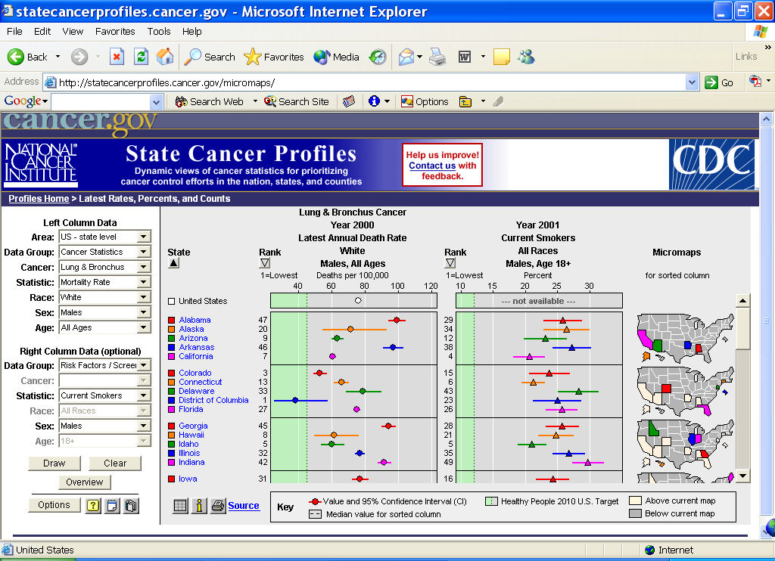

Slide 73
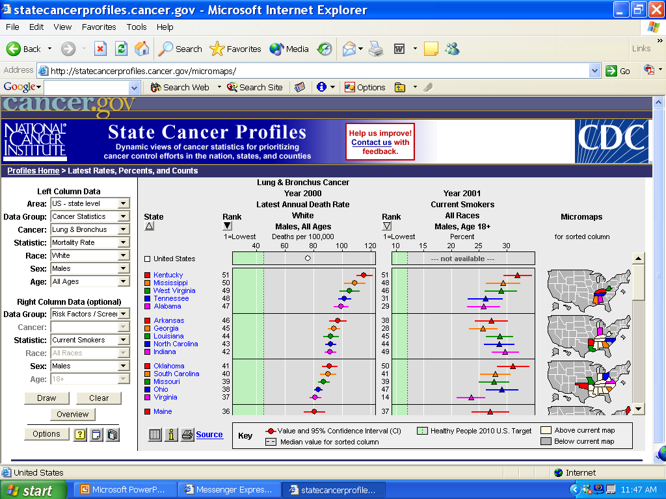

Slide 74
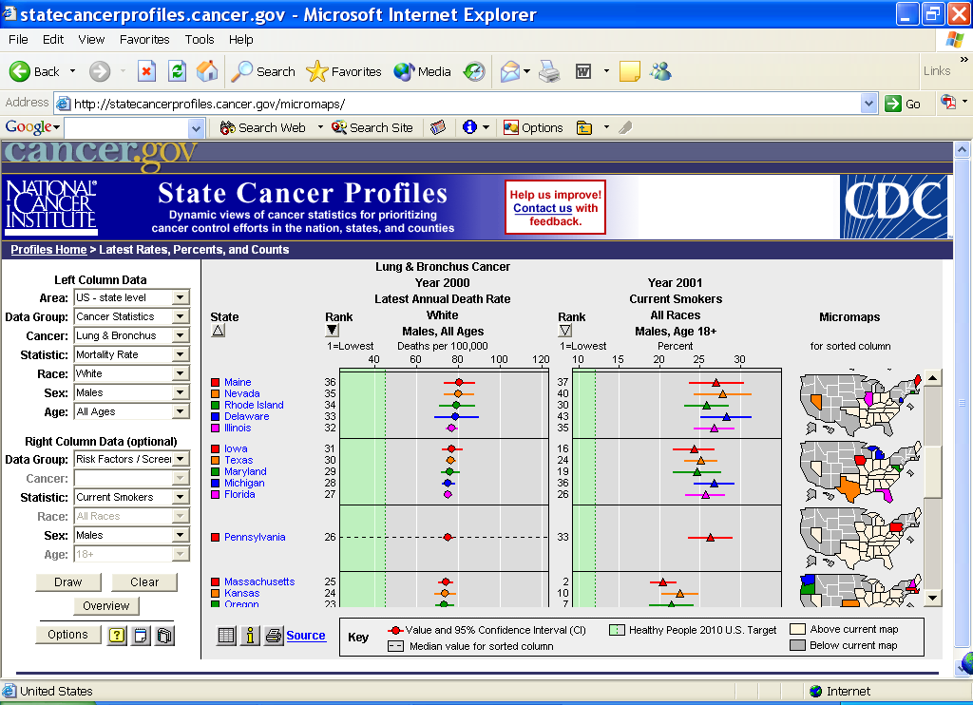

Slide 75
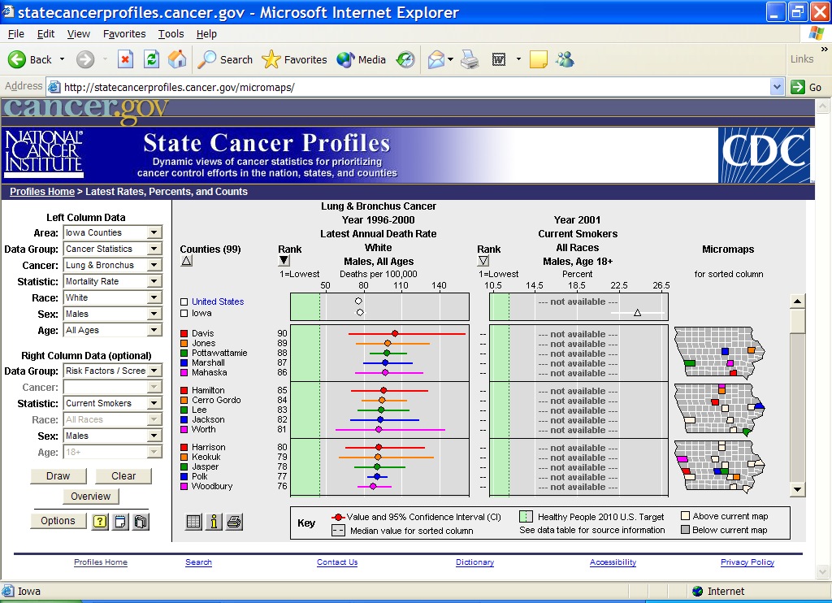

Slide 76
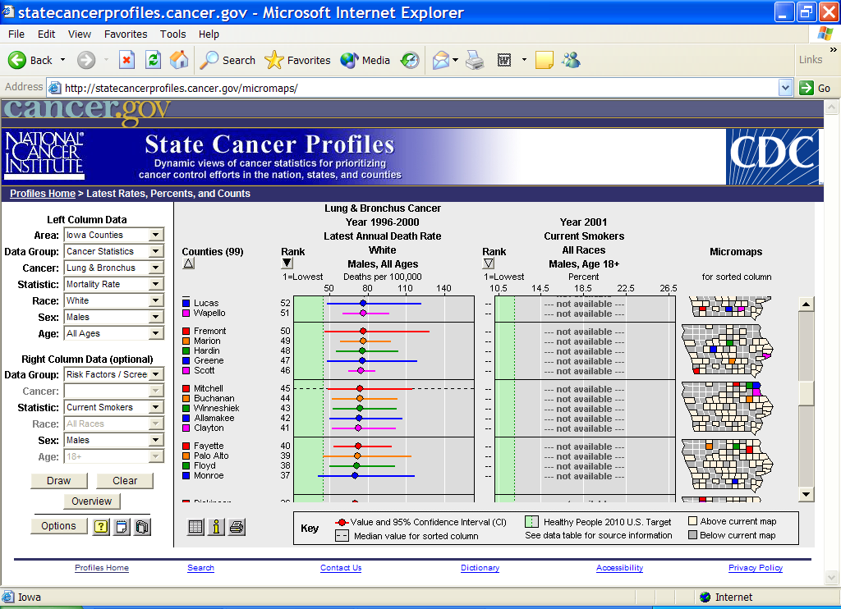

Slide 77
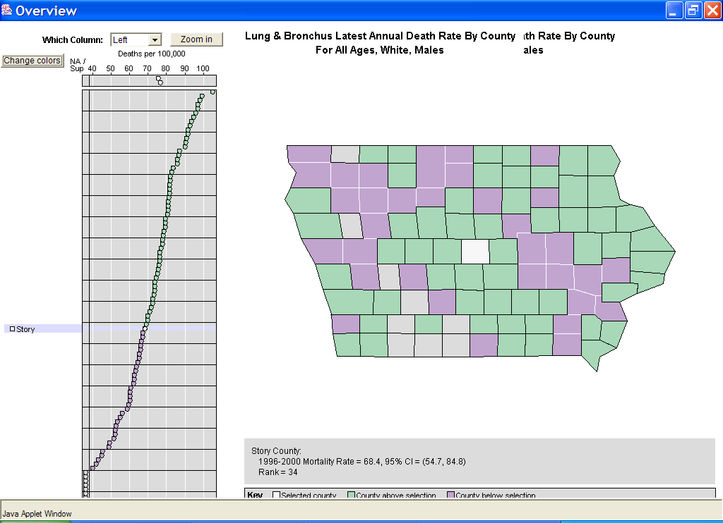

Slide 78
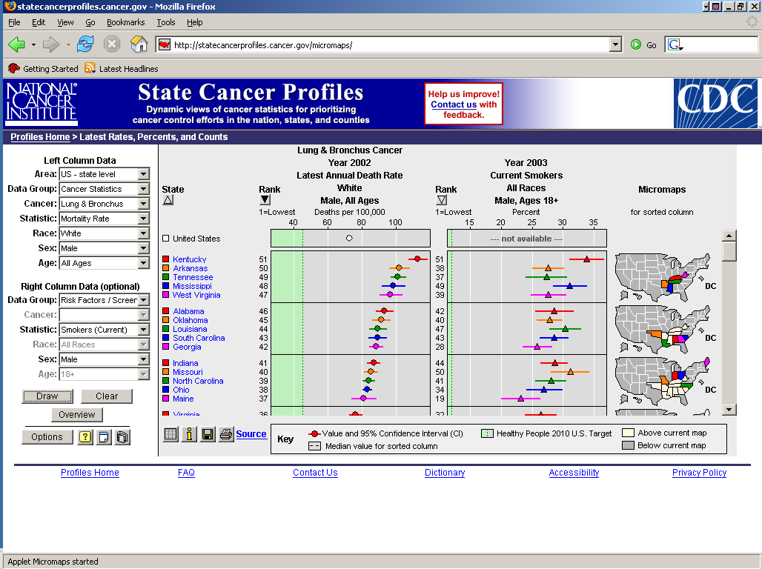
Browser
Options
Branding
Data Selection
Lost battles for visual real estate and other stories

Slide 79
Dynamically Conditioned Choropleth Maps
Purpose: hypothesis generation
Dynamically defines sub-populations
Group regions with similar risk factors
Compare grouped populations
Look for spatial patterns with groups
Today’s mortality mapping practice
Controls for race, sex and age
Doesn’t typically control for other risk factors
Exploratory analysis guidance from John Tukey
The unadjusted plot should not be made

Slide 80
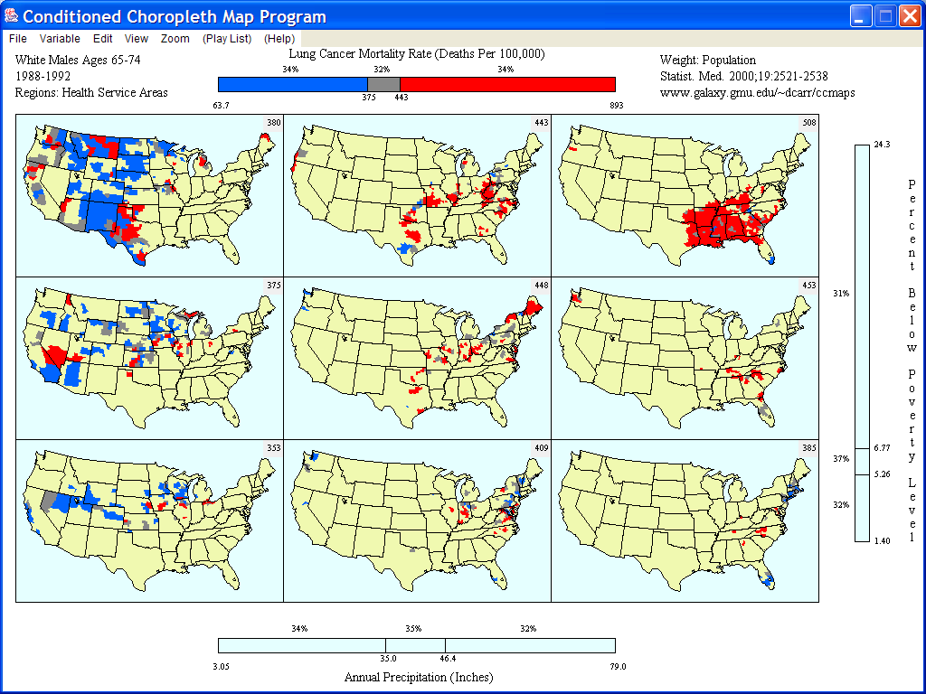

Slide 81
Conditioned Choropleth Maps Features
Dynamic partitioning sliders for
Maps, QQplots, scatterplots with smoothes
Can partition using a data quality variables
Dynamic and guiding statistics
Live Percents and R²
Anova views of cells means and interactions
Cognostics for good slider settings
Data analysis management
Variable selection from user-provided data files
Zoom, zoom history and mouseovers
Annotated snapshoots and live replay

Slide 82
Conditioned Maps: Comparisons Yielding Three Classes
Compare a variable’s values to two thresholds
Classes: low, middle, high
Actions: adjust slider thresholds, change variables
Compare confidence intervals to a reference value
Classes: below, similar to, above
Action: adjust significance levels
Variables can represent
Status
Trends
Uncertainty
Model residuals

Slide 84
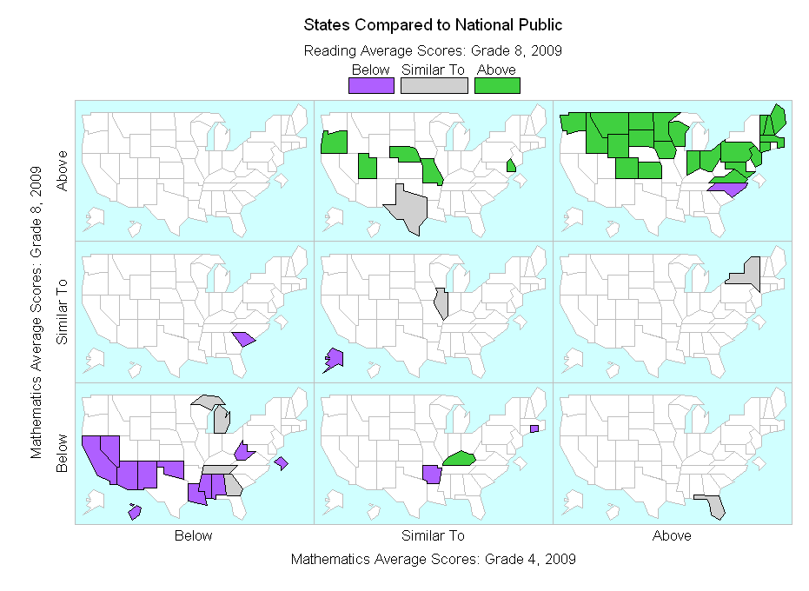

Slide 85
Advocate and Design For Future Generations
Advocate for data availability
Address human computational and memory limitations
Provide statistics to shore up loose visual impressions
Provide constructive transformations
Provide search tools and navigation aids
Address human physical and education limitations
Provide interface options and educational pathways
Link to knowledge bases
Couple data visualization with models
Tufte: “Above all else show the data.”
David Scott: “often advantageous to visualize data
indirectly through the filter of a model”
Promote cognitive research and usability tests for quantitative visualization
Exploit technological advances such as GPUs
Lean toward sensory over cultural encoding (viewgraphs below)

Slide 86
Sensory Representations
Understand without training
Need to know some communication was intended
Our visual systems perceive shapes of 3-D surfaces
Perceive patterns/meaning without training
Resistance to instructional bias
Sensory immediacy: hard-wired, fast, parallel processing
Sensory illusions persist despite knowledge that they are illusionary
Cross cultural validity
Occasional problems => cultural dictates can counter sensory
encoding
From Ware 2004

Slide 87
Arbitrary Conventional Representations
Hard to learn
It takes children hundreds of hours to learn to read and write
Easy to forget
Unless over-learned and/or continually refreshed
Embedded in culture and applications
In the U.S. red can signal danger
In China red can symbolized luck and good fortune
Formally powerful
Verbal reasoning systems
Mathematical methods – calculus, etc.
From Ware 2004

Slide 88
Cited and Relevant References - 1
* Suggested reading for this class, ** Required text
John R. Anderson
Learning and Memory: An Integrated Approach. 1995. John Wiley and Sons
Card, Stuart, Jock Mackinlay and Ben Shneiderman, Eds.
Information Visualization: Using Vision to Think, 1999, Morgan Kaufman
D. B. Carr and L. W. Pickle
**Visualizing Data Pattern with Micromaps, 2010, CRC press
W. S. Cleveland
**Visualizing Data, 1993, Hobart Press
*The Elements of Graphing Data, 1994, Hobart Press

Slide 89
Cited and Relevant References - 2
Stephen Kosslyn
*Graph Design for the Eye and Mind, 2006. Oxford University Press
George Lakoff and Mark Johnson
Metaphors We Live By. 1980. University of Chicago Press
Richard Mayer
*Multi-Media Learning. 2001 Cambridge University Press
Stephen Palmer
Vision Science: Photons to Phenomenology. 1999. The MIT Press

Slide 90
Cited or Relevant References - 3
Ben Shneiderman and Catherine Plaisant
Designing the User Interface, Fourth Edition, 2005, Addison Wesley
Edward Tufte
The Visual Display of Quantitative Information, 1983, Cheshire Press
Envisioning Information, 1990, Cheshire Press
Visual Explanations, 1997, Cheshire Press
Beautiful Evidence, 2006, Cheshire Press
Leland Wilkinson
The Grammar of Graphics, 2005 Springer
Colin Ware
Information Visualization, Perception for Design, 2013, Morgan Kaufman
*Visual Thinking for Design, 2008, Morgan Kaufman

